Slide 1
Wearable Muscle Sensing Exercise System
Senior Capstone Project
Electrical & Computer Engineering
Maseeh College of Engineering & Computer Science
Portland State University

Slide 2
Team Information
Students:
Ahmed Abdulkareem - Undergraduate Computer Engineer
Hai Dang Hoang - Undergraduate Computer Engineer
Todd Harlow - Undergraduate Computer Engineer
Thanh Tien Truong - Undergraduate Computer Engineer
Supervisor:
Mark Faust - Assistant Professor

Slide 3
Topics
Problem and Ideal Solution
Project Object
Existing Solutions vs. Our Solution
Project Design
Project Implementation
Testing
Project Costs
Summary

Slide 4
Problem and Ideal Solution
45 million American adults have gym memberships in recent year
The ideal solution:
Inexpensive and easy-to-use device
Effective at providing correct methods for many exercises
Accurate at alerting users to when they should stop
35 percent increase in workout-related injuries in recent years due to improper technique or inappropriate exercises
Many people don’t maximize the benefits of the exercises they perform because they don’t train the muscle intensely enough.

Slide 5
Project Objective
To design and prototype a wearable device that can effectively support a user’s workout by allowing them to select their targeted muscle group and a corresponding exercise. Our device will accurately count correct repetitions and alert the user when they should stop the exercise. The device should be safe, easy to use, and portable.

Slide 6
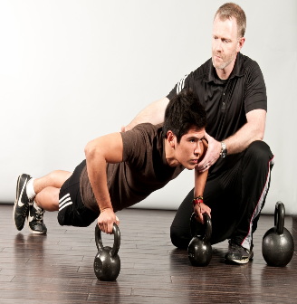
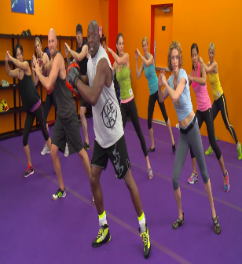
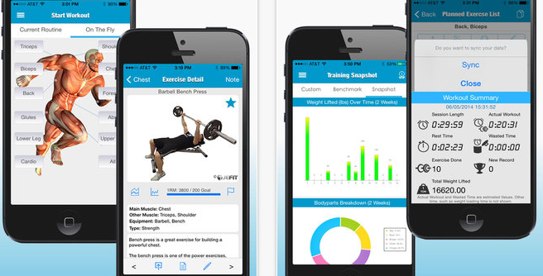
Current Existing Solutions and Our Solution
 | Personal Trainers
Cost | 1
Effectiveness | 5
Flexibility | 4
Ease of use | 5
Support all types of exercise | 5
Total | 20
Workout Videos
3
3
2
5
5
18
Videos Recording
5
3
2
4
3
17
Our Solution
4
4
5
5
3
21
A device that can:
Record the results
Correct your form
Detect muscle fatigue
Be used by anyone who wishes to improve their workouts and avoid injury

Slide 7
Our Solution
How many correct reps have I done so far?
Count the number of reps
Detect the muscle fatigue index
When should I stop?
Provide calculation for 1RM
What is my 1 RM value ?

Slide 8
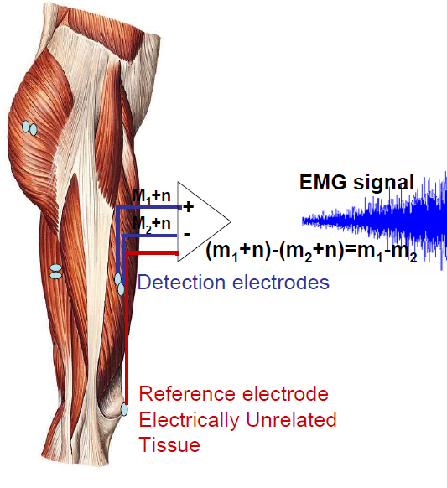
Our Solution (Technical)
We use surface electromyography (sEMG) sensors to capture the voltage difference created by a contracting muscle
sEMG signals
The signal will be amplified, rectified and integrated before being sent to the microprocessor
Baseline and threshold comparison
Did the user perform a correct rep?
Is the user’s muscle fatigued?

Slide 9
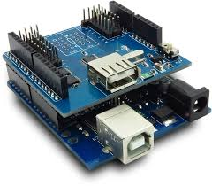
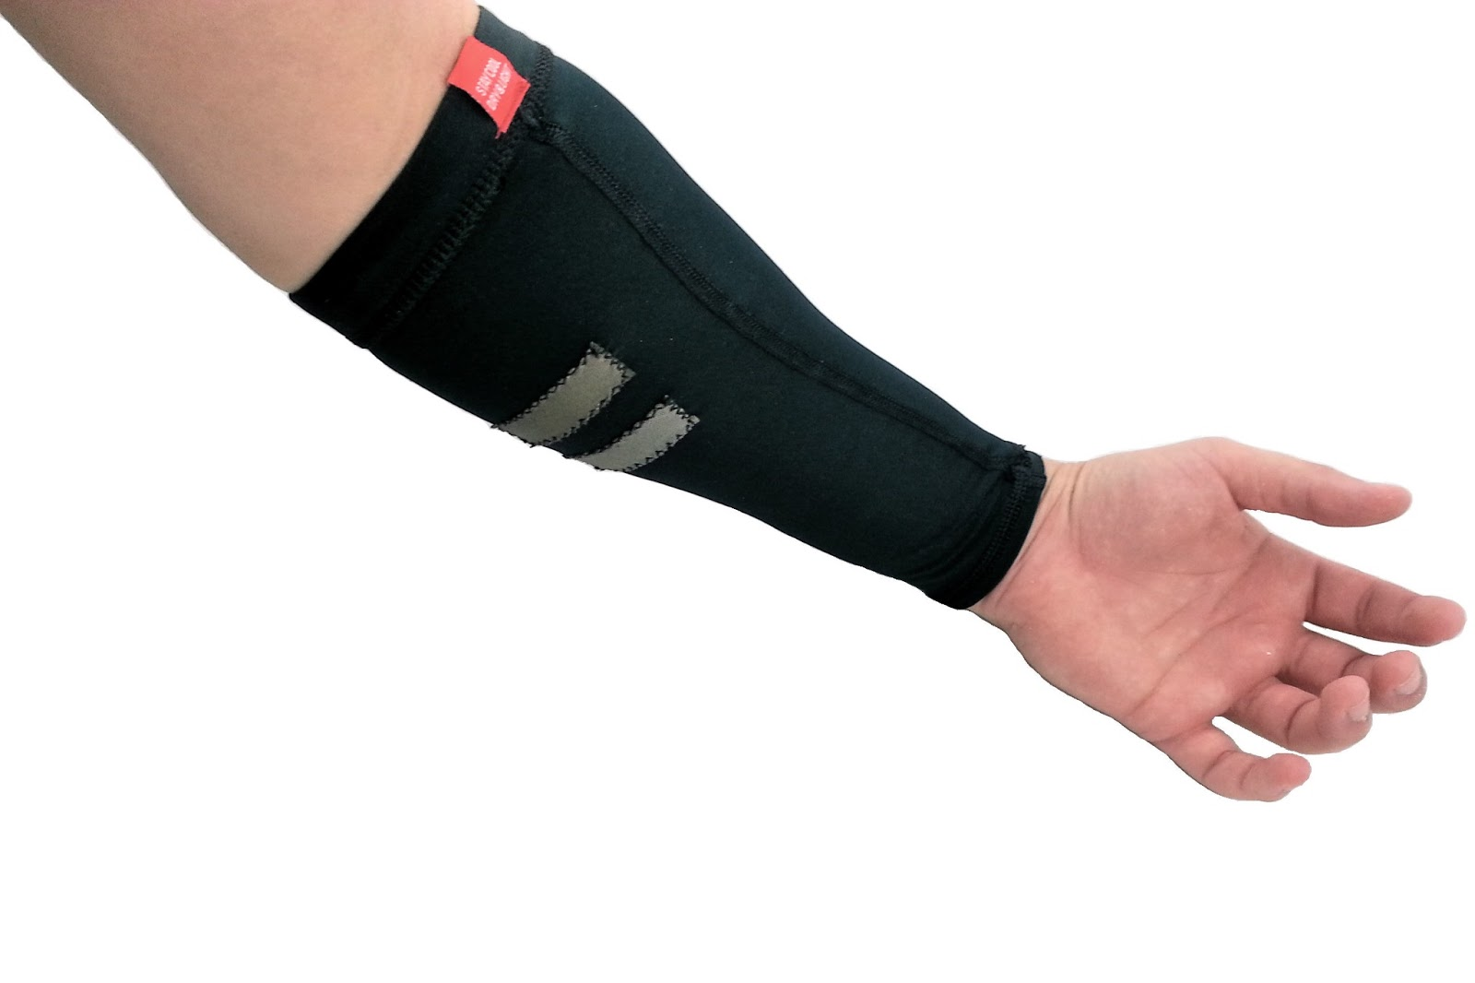

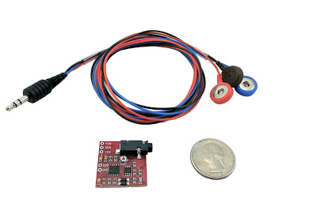
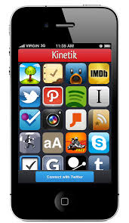
Design
Get data samples and analyze the data
Arduino board
Wearable sleeve with sEMG sensors
Capture the signal generated by the targeted muscle
Let users select muscle types
Let users select exercise types
Let user see their workout results
iPhone apps
Amplify, rectify and integrate the captured signal

Slide 10
Design Arduino
Processed Signal
Calibration’s flags
Timer
Calibration
Threshold
Detector’s flag
ADC converter
Correct reps and fatigue detector
1 KHz
Timeout’s flag
Timeout

Slide 11
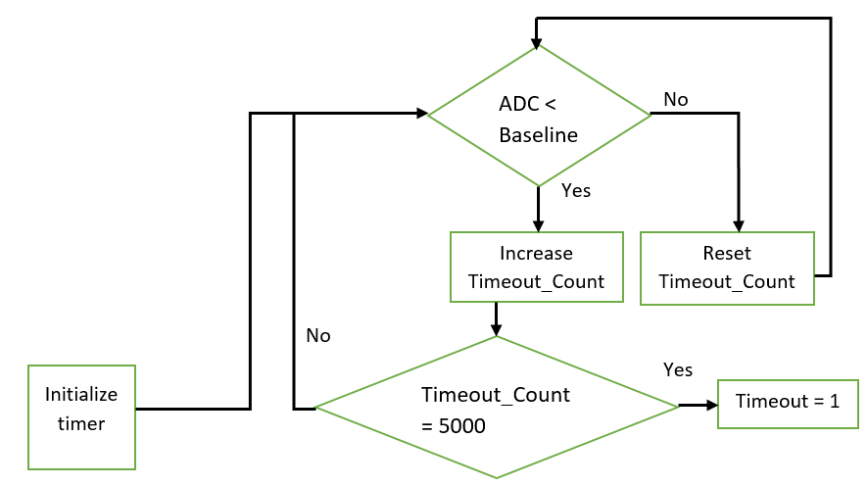
Design Arduino - Timer
Initialization:
Timeout_Count = 0
Timeout = 0
1 KHz

Slide 12
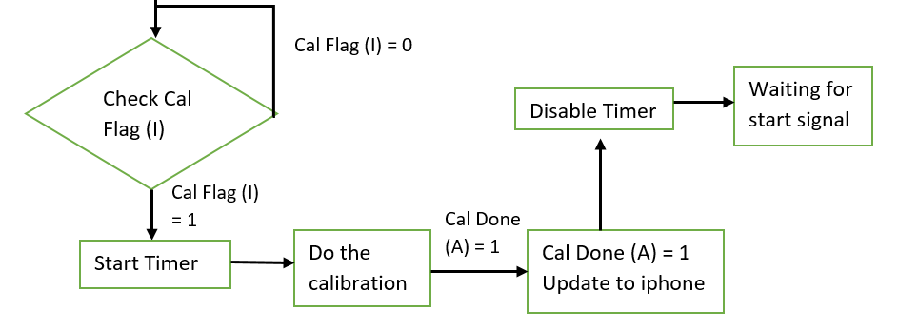
Design Arduino - Calibration
(I): Send from iPhone to Arduino
(A): Send from Arduino to iPhone

Slide 13
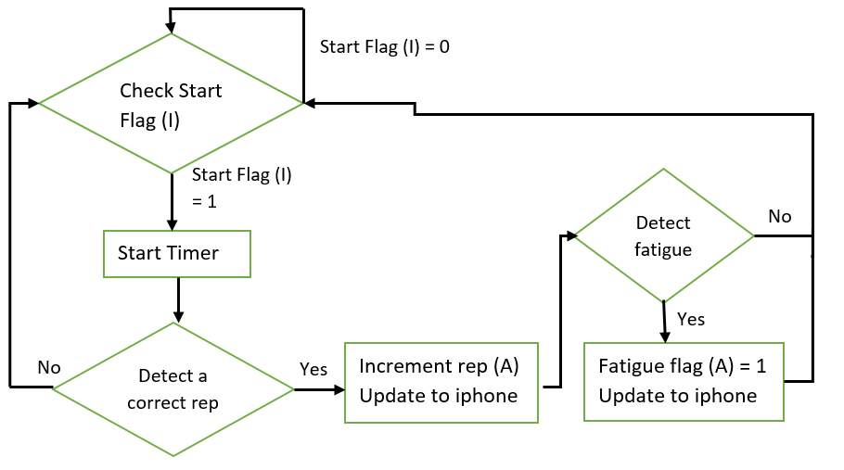
Design Arduino – High-level correct repetition and fatigue detection
(I): Send from iPhone to Arduino
(A): Send from Arduino to iPhone

Slide 14

Design Arduino – Detailed correct repetition and fatigue detection
Initialization:
MAX = 0
Curr_voltage = 1023
Prev_voltage = 1023
Start Flag is asserted
Curr_voltage = MAX
No
ADC > baseline
Yes
ADC > MAX
$$increase= \frac{curr_voltage −prev_voltage}{prev_voltage}∗100$$
No
Yes
Prev_voltage = Curr_voltage MAX = 0
MAX = ADC
No
MAX > threshold
Yes
Increment reps
No
Increase > 17
Yes
Fatigue = 1

Slide 15
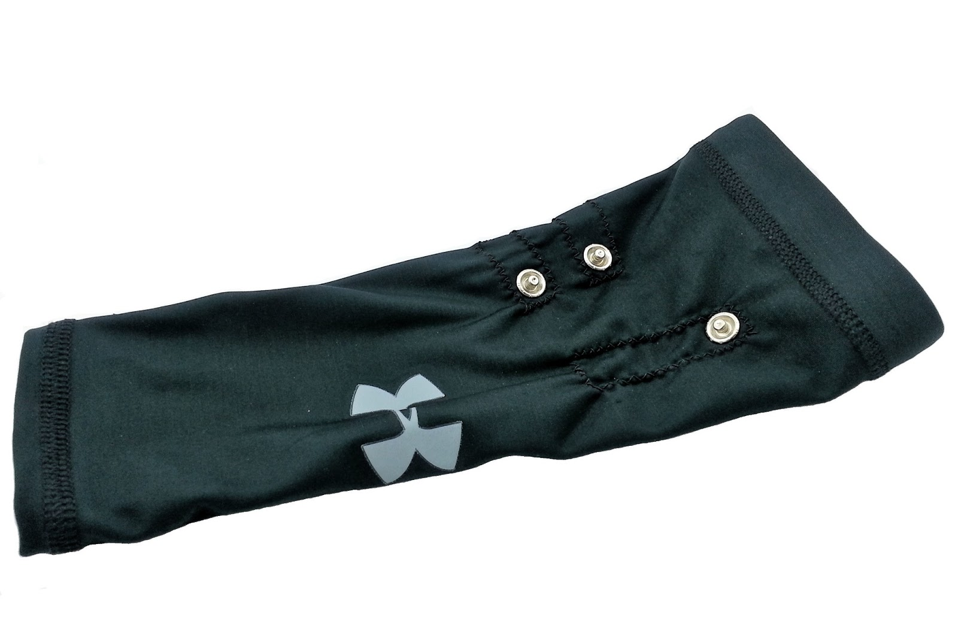
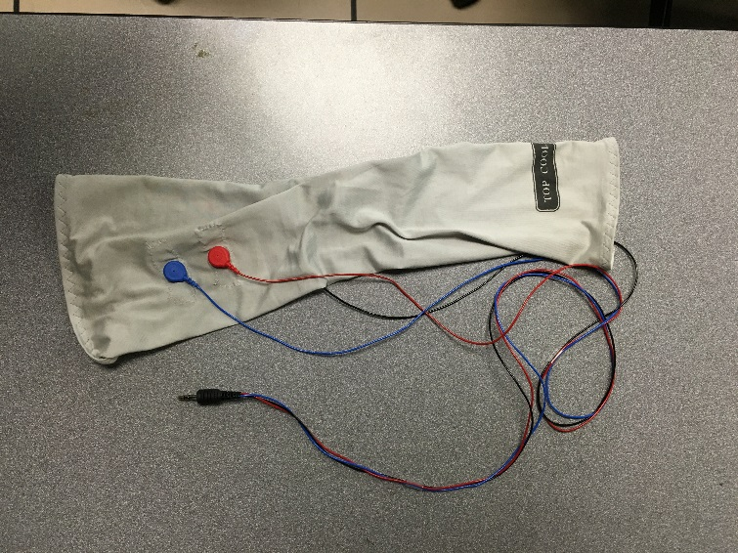
Electrode Sleeve Measures muscle activity via electrical signals on the user’s skin
Electromyography
Activated motor units in muscles produce voltage differentials
Amplitude: < 10 mV
Frequency Range: 20 – 500 Hz
Electrode Styles
Needles inserted into the muscle (OUCH!)
Contacts placed onto skin surface (MUCH BETTER ☺)
Implementation
Followed example from Muscle Sensor website
Uses conductive fabric as surface electrodes
Uses button snaps to easily connect leads to Muscle Sensor
Wetting electrodes before use greatly reduces signal noise and fluctuations
Example sleeve from Muscle Sensor website
The sleeve made for our project

Slide 16
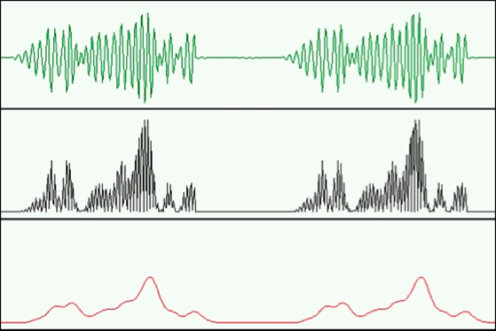
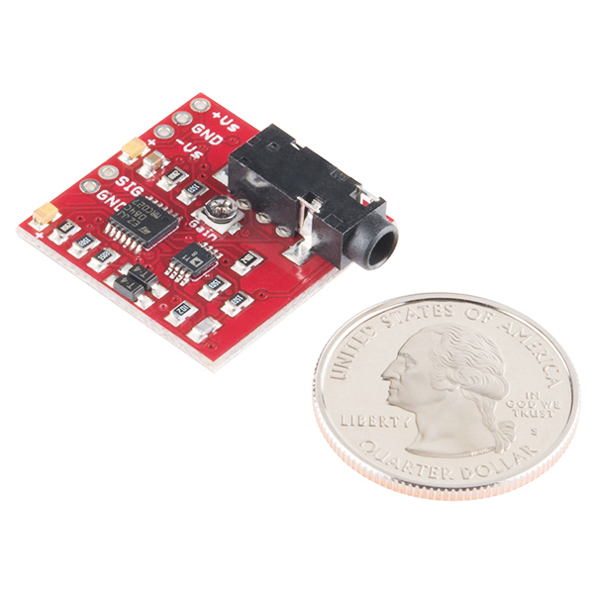
Muscle Sensor V3 Conditions the electrode’s signal to work with the analog-to-digital converter on the Arduino
Amplify
Input signal from electrodes is weak ( ~10 mv )
Boosts signal up to + supply voltage ( 5 V )
Rectify
Transforms +/- signal to + only
Smooth
Integrates the rectified signal
Amplified
Rectified
Smoothed

Slide 17
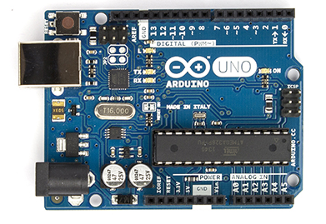
Arduino UNO Digital “brain” of project
Analog-to-Digital Converter
Converts analog signal from Muscle Sensor V3
Timer
Generates interrupts for 1kHz sample rate
SPI
Communicates with Bluetooth device
Atmega 328P
Implements algorithm detect muscle fatigue
and rep count

Slide 18
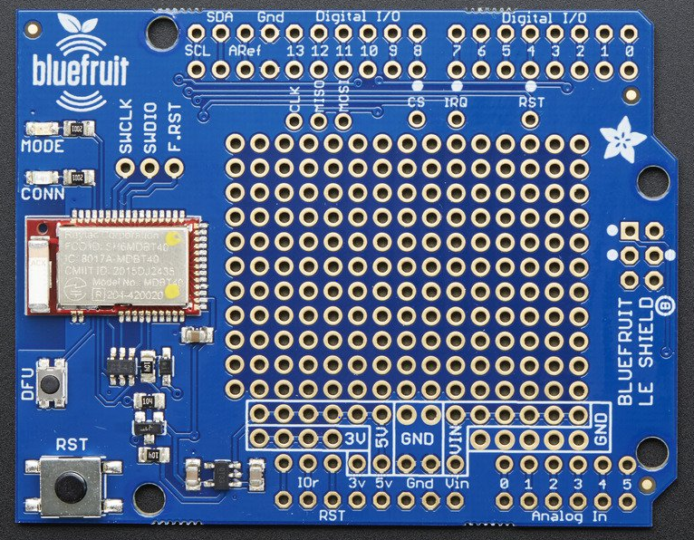
Bluefruit LE Shield Provides Arduino with Bluetooth capabilities
Technical Specifications
ARM Cortex M0 core running at 16 MHz
256 KB flash memory
32 KB SRAM
Transport: SPI at 4MHz
Benefits of using Bluetooth low energy (BLT)
Short range
Robust and efficient
Low cost, low power
Connectivity to newest mobile phones
Well-established and stable standard
Bluefruit EZ-Link Shield V1.3

Slide 19
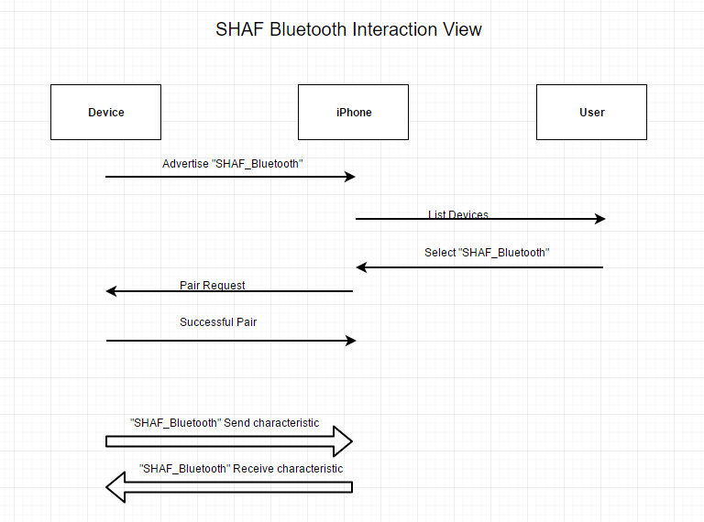
SHAF Bluetooth Interaction view

Slide 20
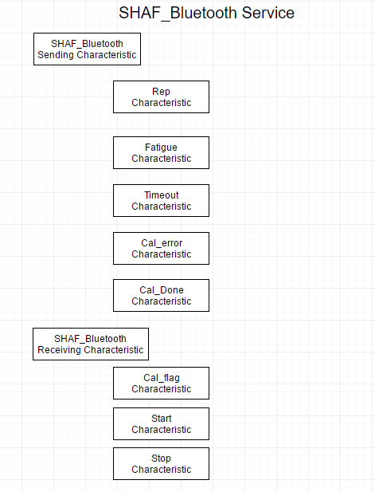
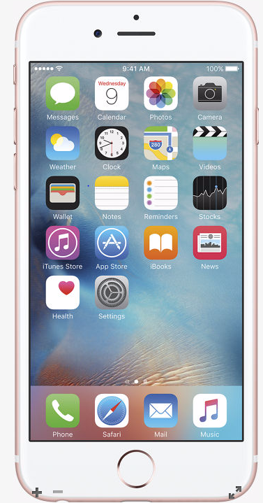
SHAF Bluetooth Communication Hierarchy

Slide 21

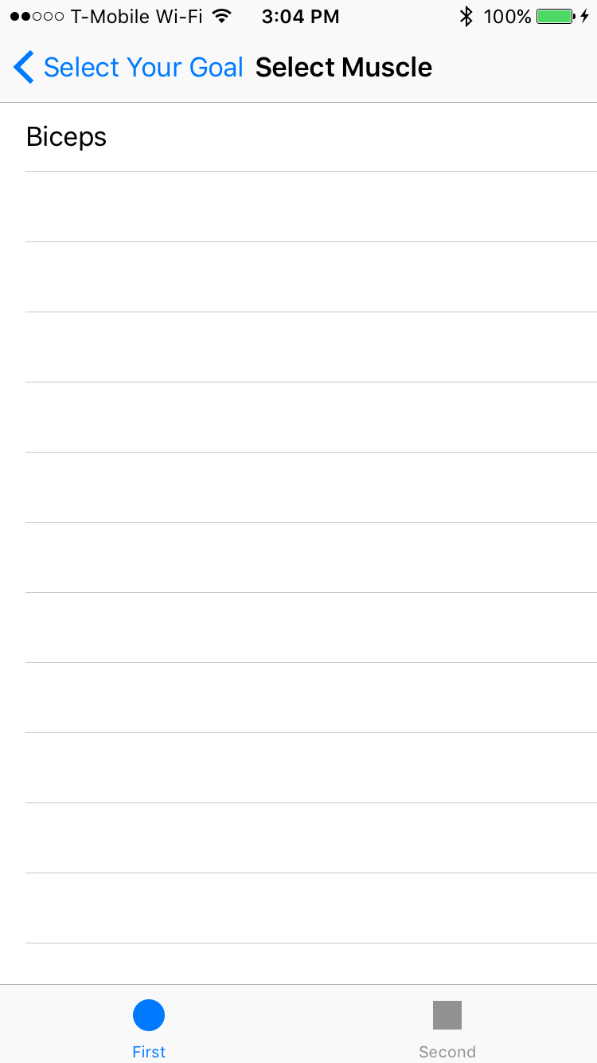
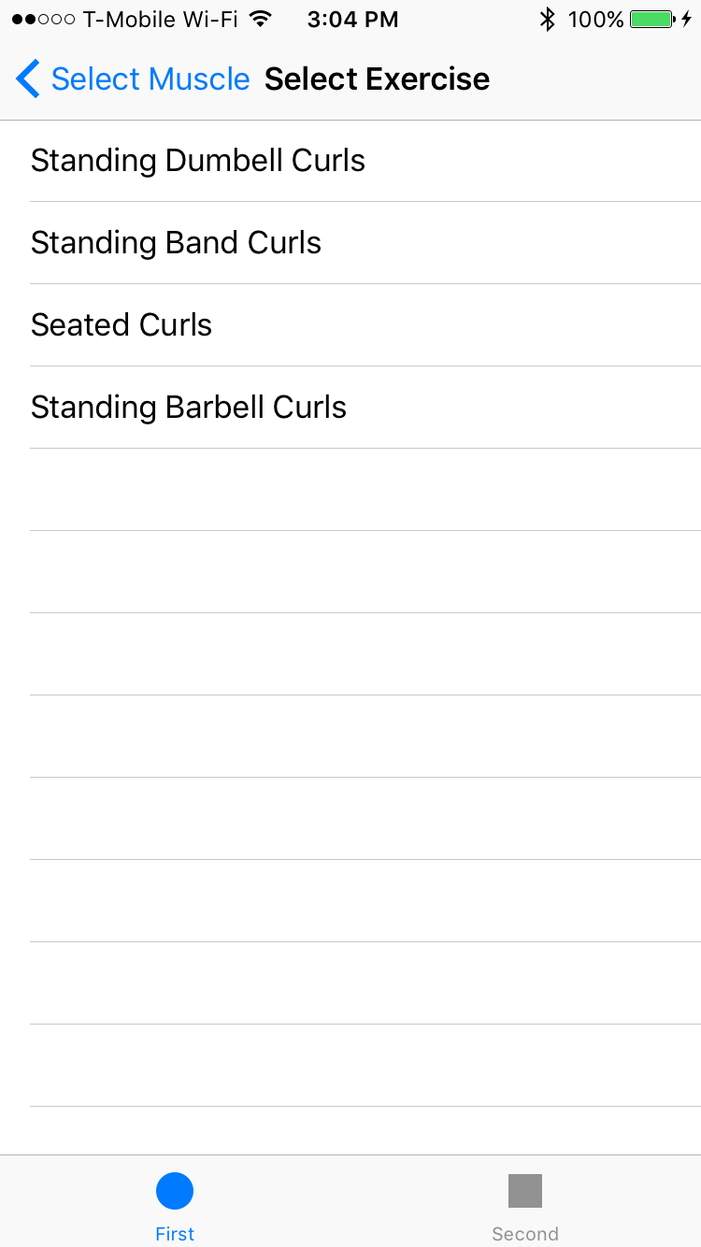
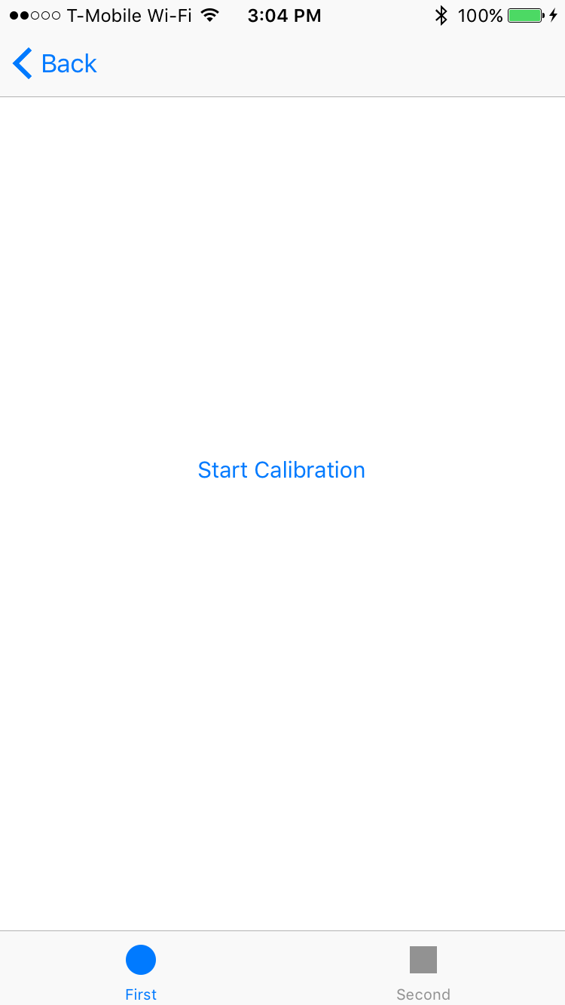
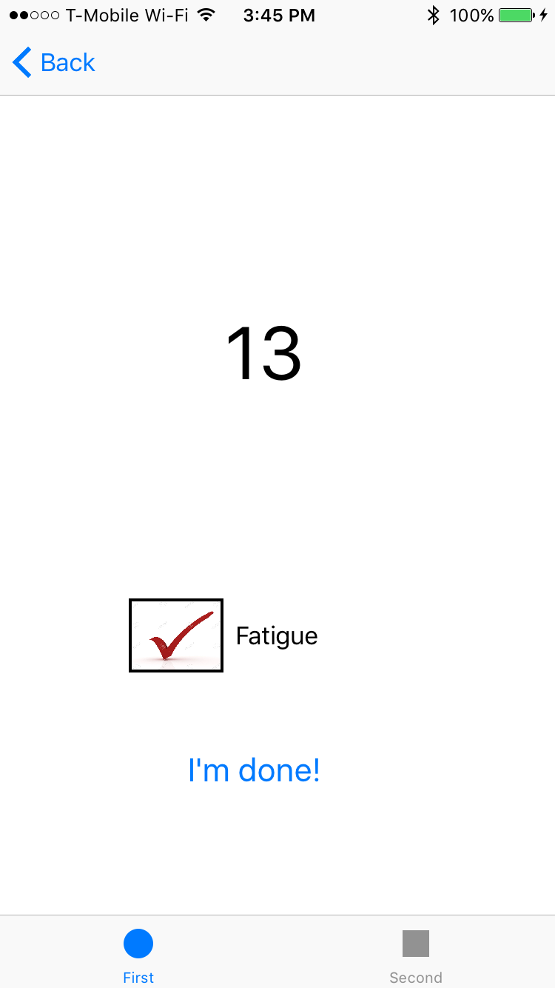
iPhone
Provides graphical user interface (GUI) for controlling the system
Select Muscle
Select Exercise
Calibrate
Feedback

Slide 22
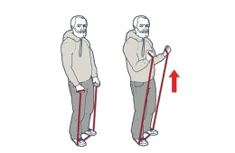
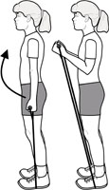
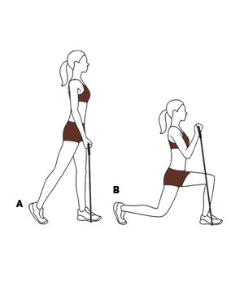
Data Collection Testing our setup with many subjects
“Am I doing this right?”
Methodology
24 subjects total (13 male, 11 female)
Using resistance bands, each subject performed 4 sets of bicep curls until they felt they couldn’t do another
Reps were counted and recorded
Fatigue assumed to be at or near last rep
Testing our equipment
Electrode Sleeve->Muscle Sensor->Arduino
Log file from Arduino terminal used capture data
Muscle Sensor output also sent to oscilloscope
Plotted Arduino data compared to scope for verification
Observations
Wide variety in how people perform bicep curls
Some subject’s arms too small for proper sleeve fit
Inconsistency in self-reported fatigue
(Some users worked until failure and others did not)
“Try keeping your back straight.”
“I like to lunge when I curl!”

Slide 23
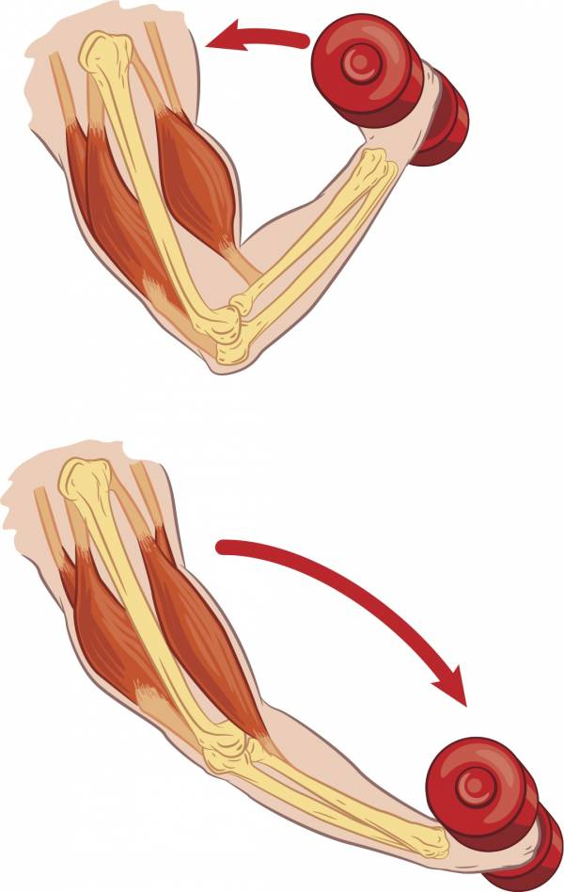


MATLAB Analysis Testing and tuning our algorithms using the data we collected
Repetition Detection
Parameters = { BASELINE, THRESHOLD }
Initial parameters used to detected first rep
First rep used to calibrate parameters
(1st Rep Peak ) * {BASELINE, THRESHOLD}
Subsequent reps detected using new parameters
Fatigue Detection
Parameter = { FATIGUE }
Percent difference between last two reps compared to parameter
Remains constant during processing
Log File
Log File
Log File
Log File
Analysis
Results
Log Files

Slide 24
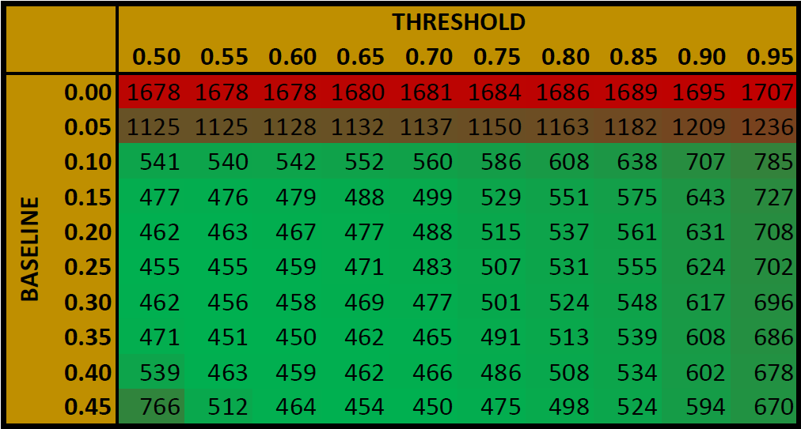
MATLAB Analysis Testing and tuning our algorithms using the data we collected
Batch Processing – Rep Detection
100 runs for each data set
10 BASELINE fractions, 10 THRESHOLD fractions
10x10 output matrix of rep counts
Absolute difference between observed count for data set and each matrix element
All difference matrices summed
Index of summed matrix that’s closest to zero represents the ideal BASELINE and THRESHOLD fraction
Bad Rep Detection:
“calibration” failed, only 4 reps recorded out of many
Amplitude (ADC bits)
NOTE: Red squares denote when the algorithm detects a new rep
Time (s)
Good Rep Detection:
“calibration” succeeded, all reps counted correctly
Amplitude (ADC bits)
Ideal BASELINE = 0.35
Ideal THRESHOLD = 0.60
Time (s)

Slide 25
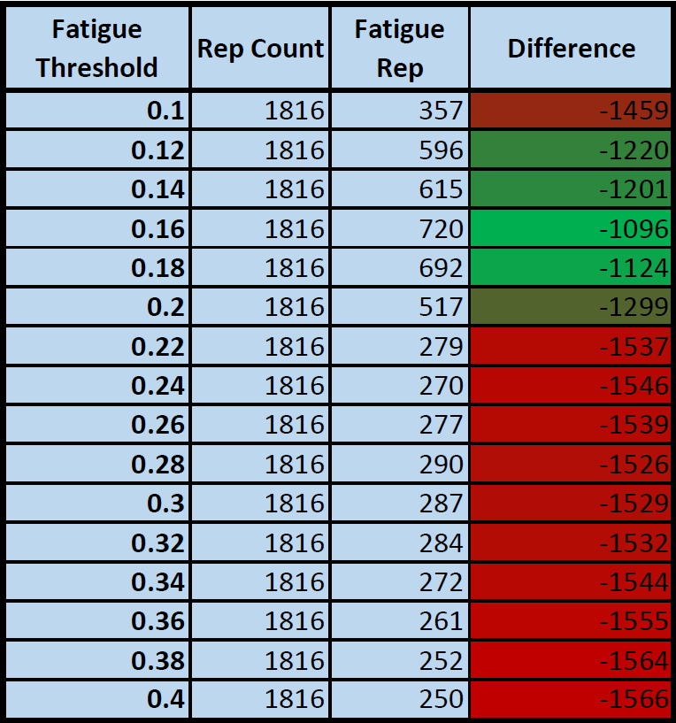
MATLAB Analysis Testing and tuning our algorithms using the data we collected
Batch Processing – Fatigue Detection
This method assumes that fatigue should first be detected on or near the last rep
16 runs for each data set
16 different “fatigue threshold” fractions
16x4 output matrix
1st Column: Fatigue Threshold used for processing
2nd Column: Observed Rep Count
3rd Column: Rep # where fatigue first observed
4th Column: Difference between 1 & 2
All result matrices summed
Index of summed matrix where column 4 is closest to zero represents the ideal “fatigue threshold” fraction
Ideal FATIGUE THRESHOLD = 0.16

Slide 26
Project Cost
Quantity | Item | Cost Per Unit | Total Cost
1 | Arduino UNO | $25 | $25
1 | Bluefruit LE Shield | $20 | $20
3 | Muscle Sensor V3 | $35 | $105
10 | Gel electrodes | $6 | $60
1 | Athletic compression sleeve 3-pack | $15 | $15
2 | 24-piece button snap kit | $5 | $10
1 | Square yard of conductive fabric | $30 | $30
 | TOTAL COST |  | $265

Slide 27
Summary: What Worked
Electrode Sleeve
When wetted properly, fabric electrodes reliably capture muscle activity
Time-domain rep detection
Works well if user sleeve is worn properly and calibration is done correctly
Time-domain fatigue detection
Works well in lab setting when consistently performing correct reps
Arduino/iPhone communication
Devices work together using Bluetooth
iPhone app
Successfully developed and deployed an iPhone app that controls our system

Slide 28
Summary: What Didn’t Work
Frequency-domain fatigue detection failed
We spent a lot of time trying to get this to work but it was a dead end
Data collected for MATLAB analysis was not ideal
Exercises should have been better supervised
User’s should have performed calibration reps similar to end product
Definition of “fatigue” should have been clearer
This affected the reliability of MATLAB analysis results
Time-domain fatigue detection did not work on collected data
Partially due to analysis methodology (no concrete “fatigue rep” recorded)
Literature not promising for time-domain fatigue detection in muscles
Project Schedule
Never completed all revisions, ended up working week-to-week, creating ambiguity
Design Documentation
A lack of documentation early in the project led to confusion about project goals and design decisions

Slide 29
Summary: Lessons Learned
Research
Rigorous research early in the project can prevent many missteps
Design, Design, Design!
Every major component for a project should have a design document that is reviewed by the entire team
Collaboration
Every team member should be familiar with the tools used for the project
Project schedules help keep the project on track and maximize productivity
Specifications
Key specs for project components should be clearly understood before ordering parts

